Slide 1

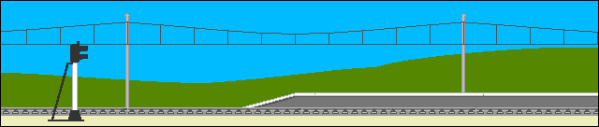
Online Train Ticket Reservation
Group No: 4

Slide 2
Contents
Introduction to the Topic
Used Technologies
Functionalities of the system
Other Important Facts
Summery
References
Questions and Answer part

Slide 3
Introduction
Our topic is online train Reservation
In This web site you can view the distance from matara to any where via train traveling
You can view train Time table.
And You can view special Notices about railways in this site
And You can view the train travelling Gallery

Slide 4
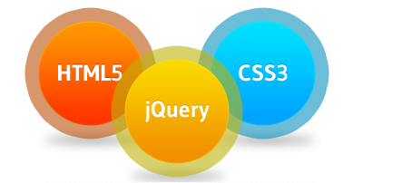
Used Technologies
HTML
CSS
Java Script
jQuery

Slide 5
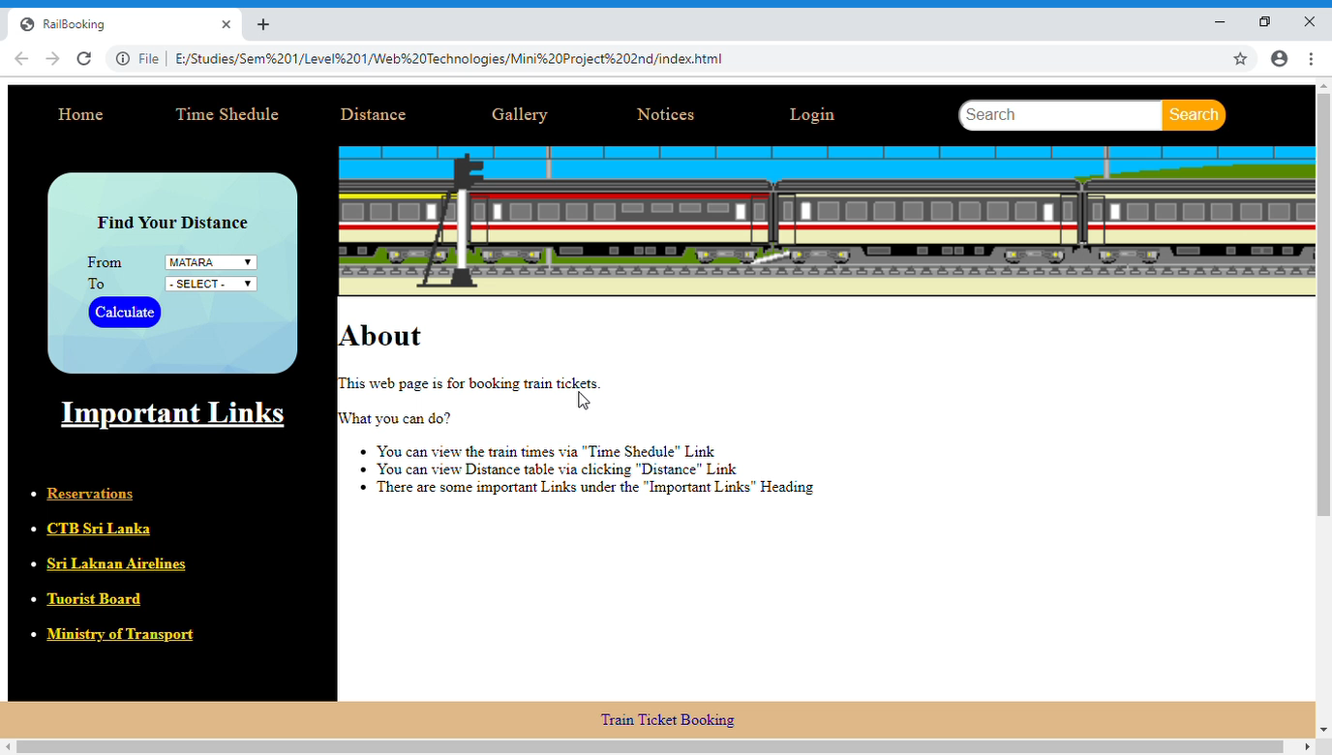
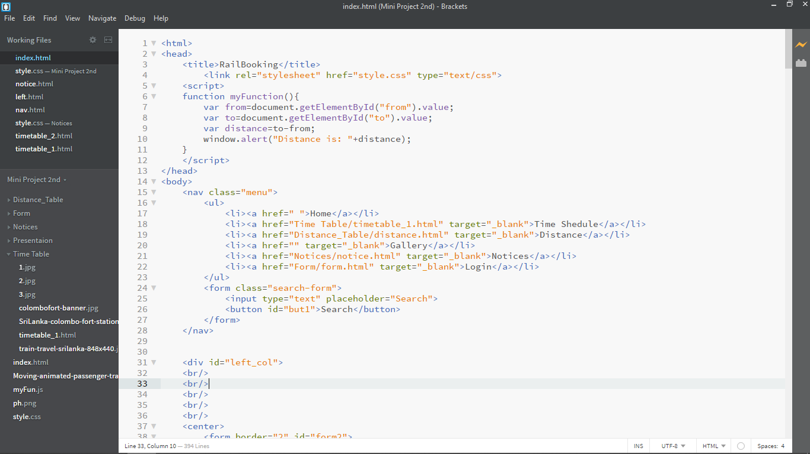
Functionalities of the system
Distance Calculator

Slide 6
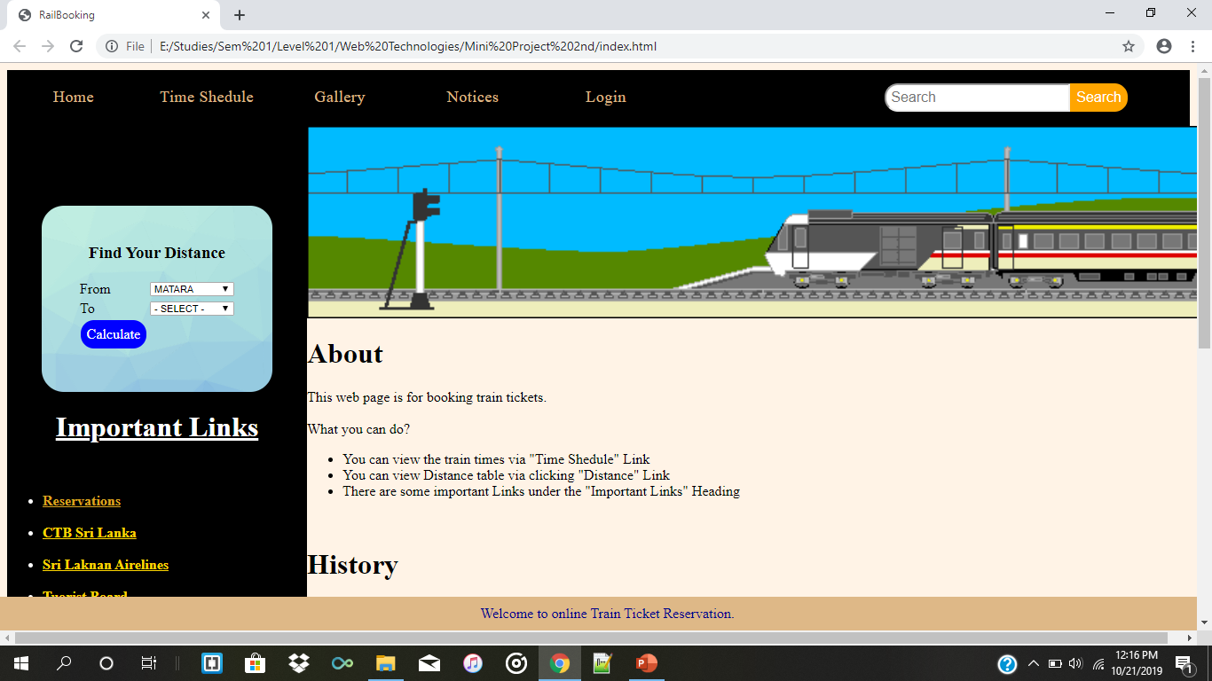
1
2
3

Slide 7

Notices

Slide 8
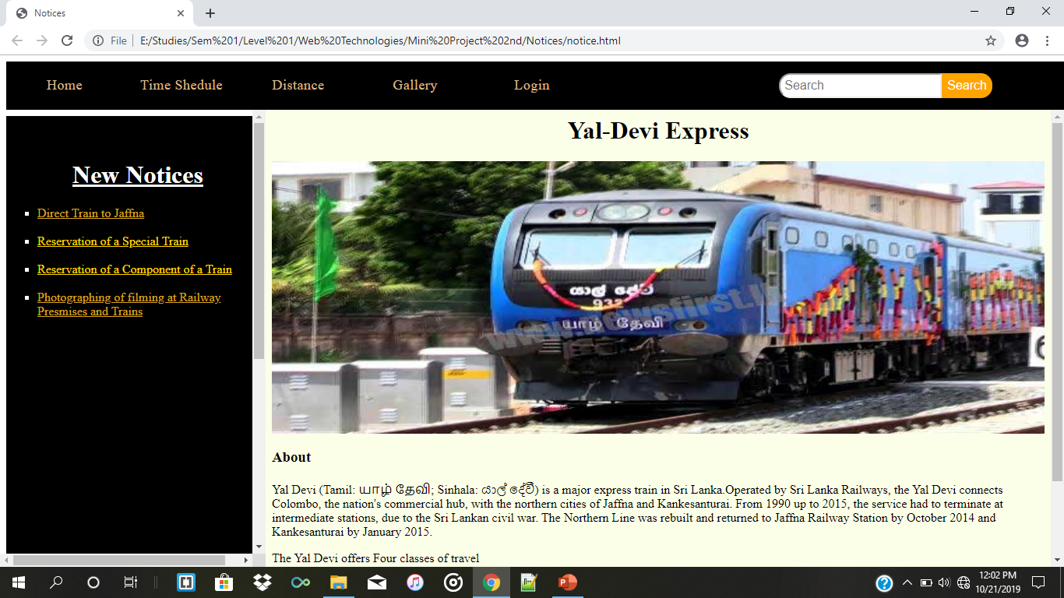

Slide 9
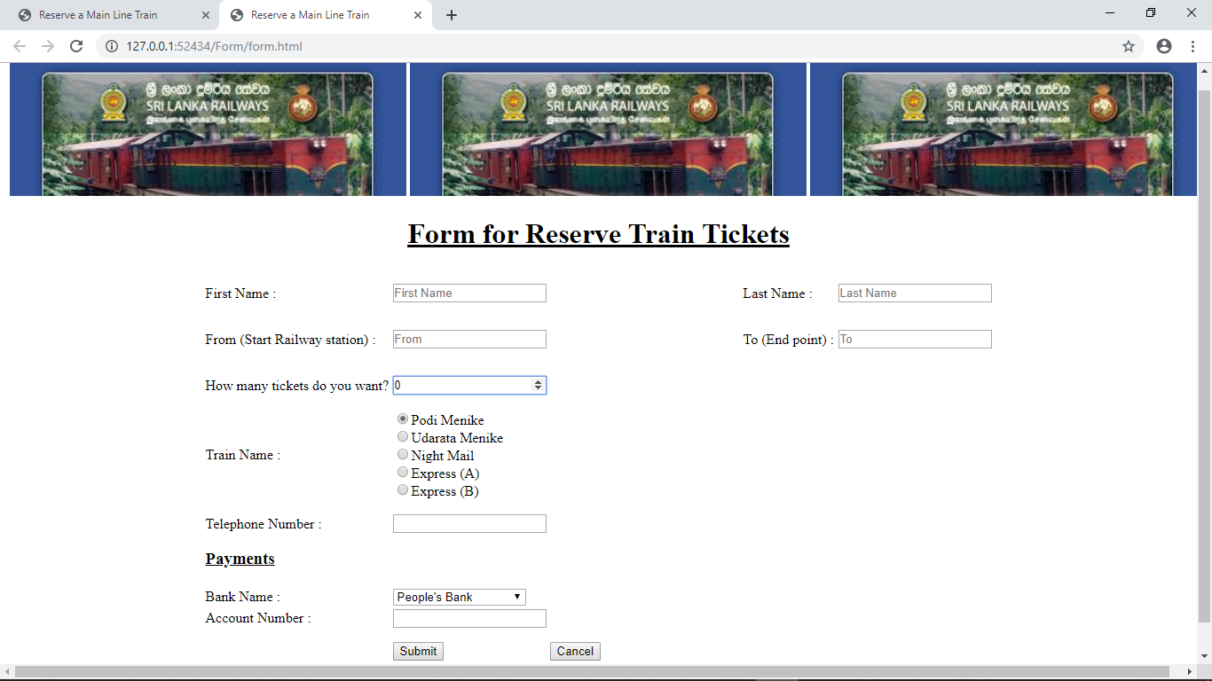
Form to Book Train Ticket

Slide 10
Advantages of Using this Web page
We can reserve train tickets/compartments anytime and from any where.
Can know about train times and travelling distance.
Quickly can receive the news about Railway via Notices.
Everyone can know the payments about railway premises from any where
This is very useful for tourist to plan about their Train travel.

Slide 11
Summery
We have used HTML, CSS, Java Script, jQuery for this web site
In this site you can view the Time table and distance of travelling in Sri Lanka via train
You can reserve the train sheets using this web site

Slide 12
References used to Create Web Site
http://www.railway.gov.lk/web/index.php?option=com_content&view=article&id=61&Itemid=68&lang=en

Slide 13


Slide 14
Thank You
Group Members:
Kavindu TG/385
M.R.Muhannadh TG/386
Pavani TG/387
Farwin TG/388

